Slide 1
Work System Design Lab
Time Study of Assembly and Machining Jobs.

Slide 2
Assembly of Bolt and Nuts.
Assembly of Bell.

Slide 3
Assembly of Bolt and Nuts
Objectives: To perform a method study on the assembly of a nuts and bolts as an individual and as a batch. Hence understand the working of individual assembly and batch assembly of jobs.
Materials required:
1. Nuts and Bolts
2. Spanner and Plates
3. Washers
Operation:
The dismantled nut and bolt assembly is placed over the given workplace and prepare a rough sketch of the components and the layout of the assembly.
The given nuts and bolts are assembled using the sample assembly as an individual.
The time consumed for each operation is noted down.
The Cumulative time consumed for the whole assembly need to find out.

Slide 4
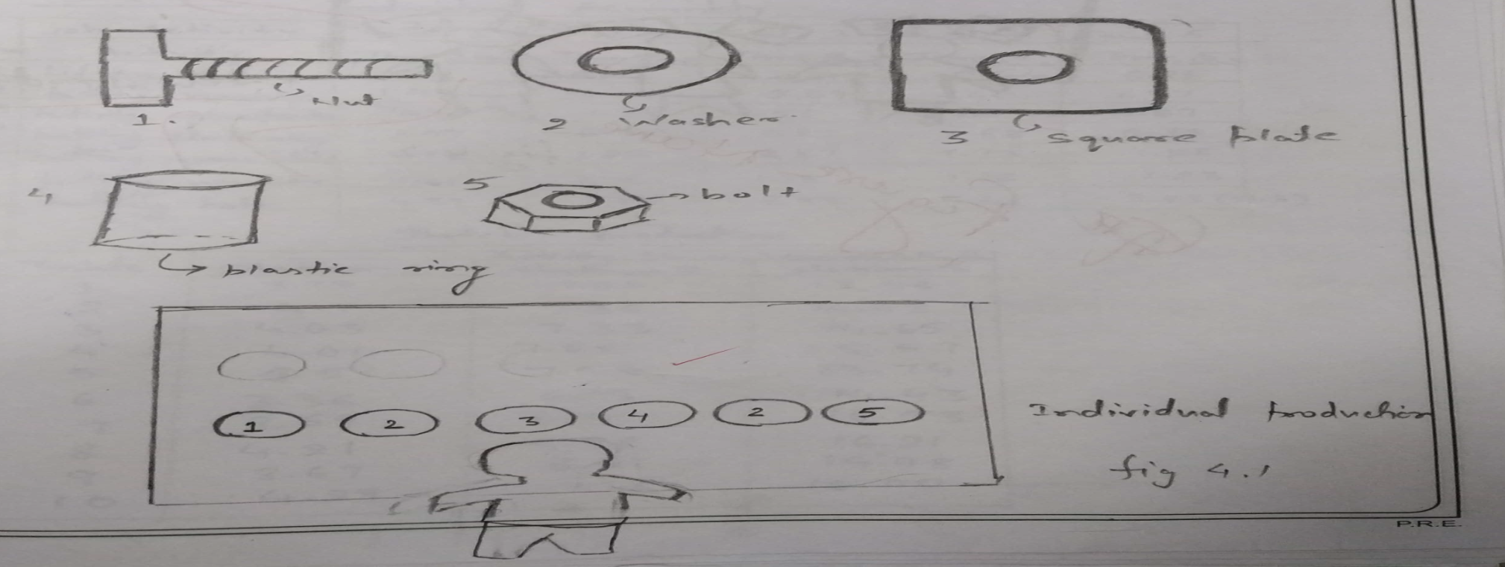
Contd..
5. The procedure is repeated as batch production in a group considering each member to be in charge of a workstation.
6. The time consumed at each work station is find out and hence find the cumulative time.
7. The procedure is performed for various arrangements with sketch and record the time of each of two trials for each member.
Diagram:

Slide 5
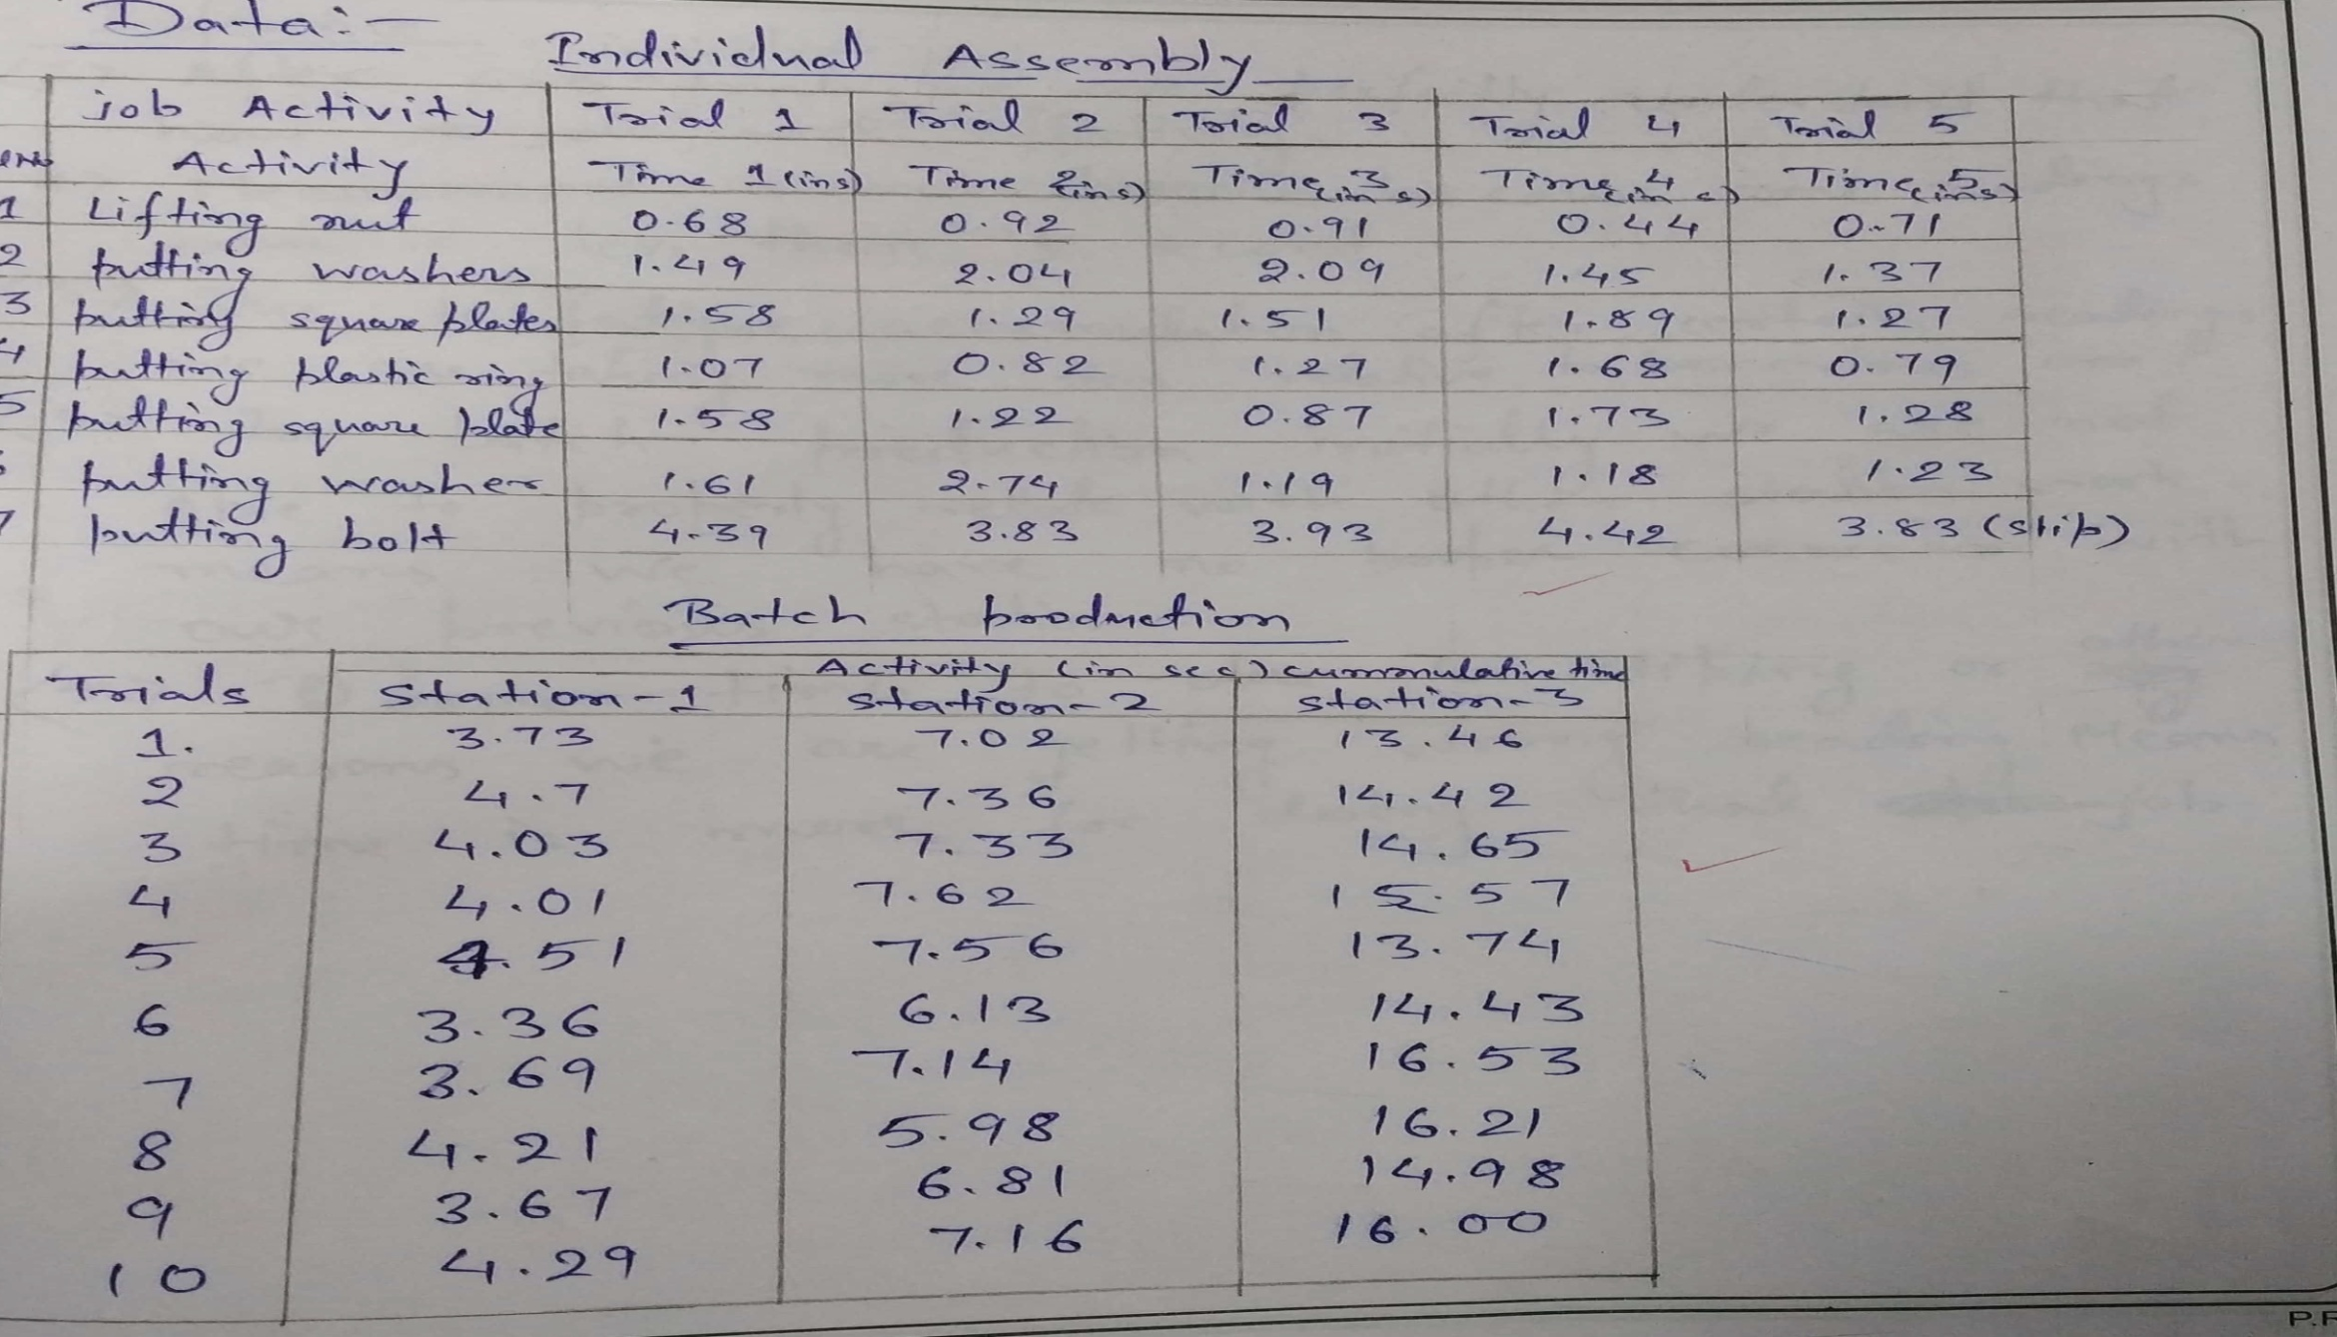
Data:

Slide 6
Assembly of a Bell
Objective: To perform a method and time study on the assembly of bell and hence construct a two hand activity chart.
Material Required:
Bell assembly
Screw driver
Spanners (of apt size)
Pencil, Paper
Operation:
1. The bell assembly is disassembled.
2. The dismantled parts of the bell are assembled in a particular way over the workplace.
3. A rough sketch of the workplace and the Arrangement of the dismantled parts of the bell (a top view of the arrangement is preferable) are drawn.

Slide 7
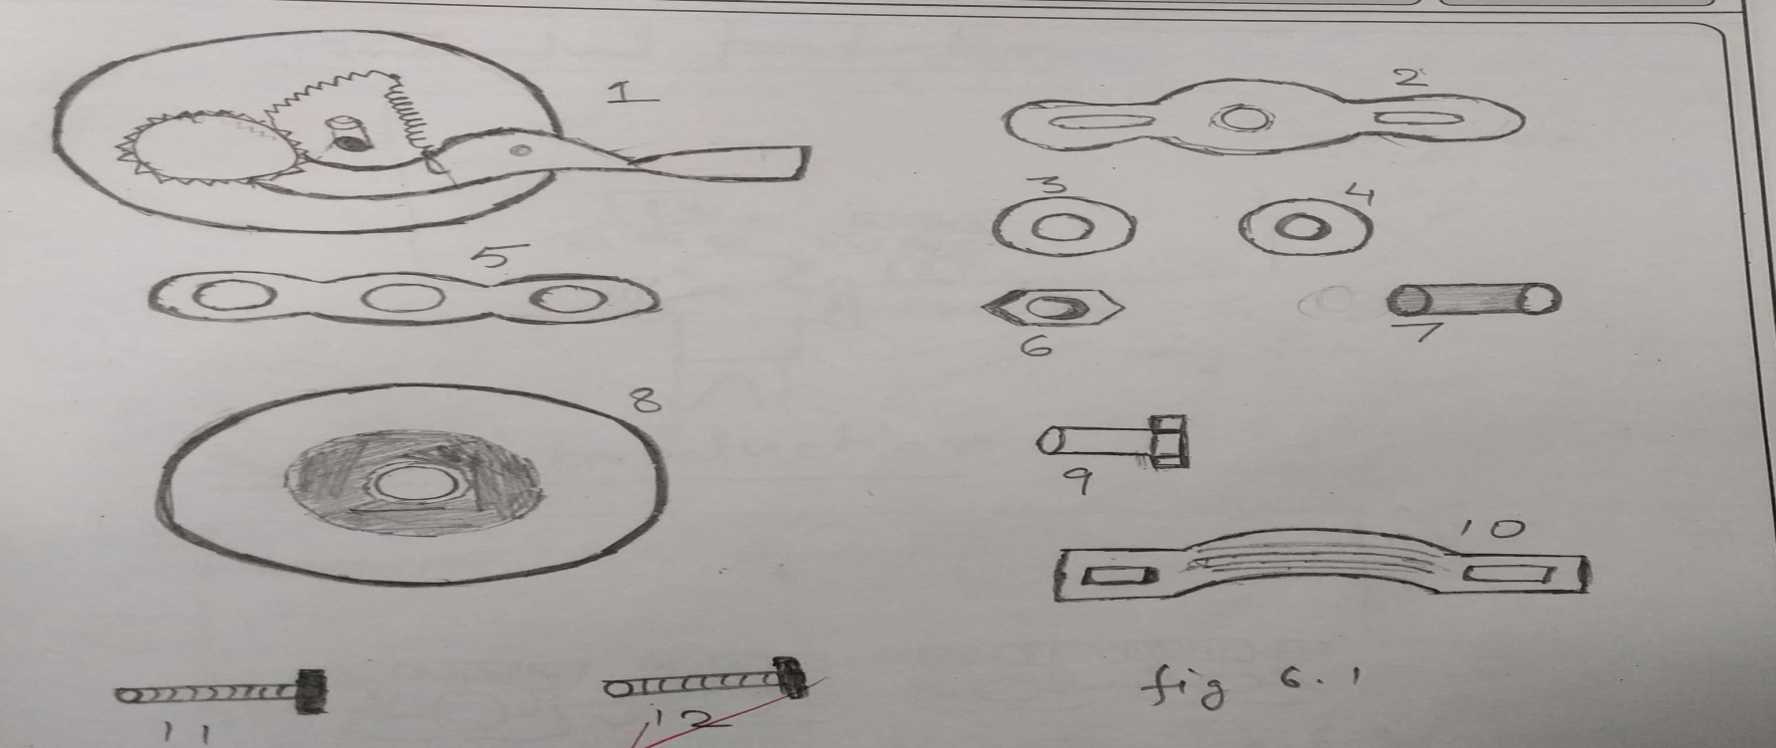
Bell Assembly Contd..
4. Assemble the parts in a sequence as shown in the picture and record the time of each operation.
5. The operation for different arrangements is repeated for five times and consequently prepare a sketch for the same.
6. The best method for the assembly of bell is accessed.
Diagram:

Slide 8
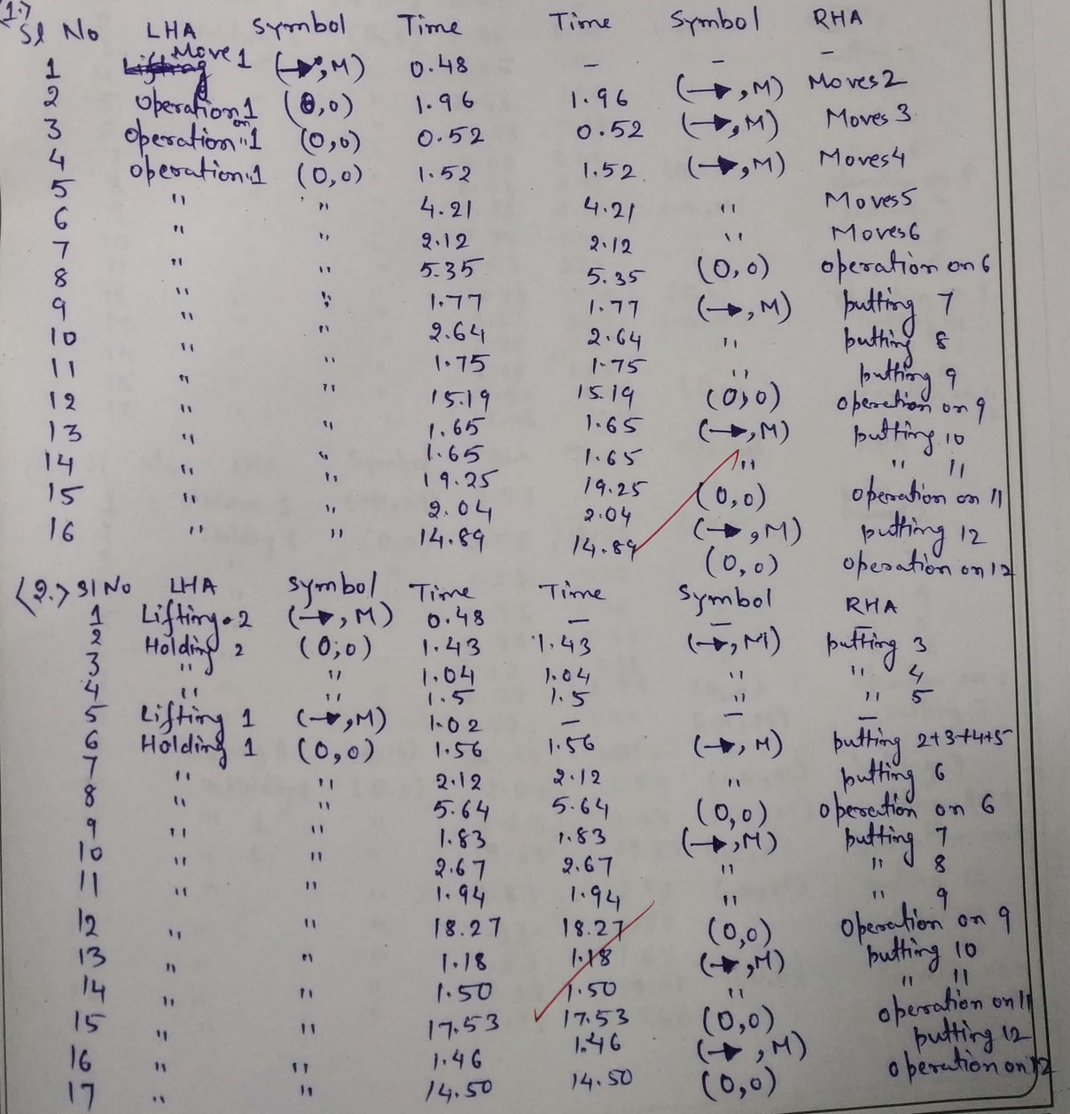
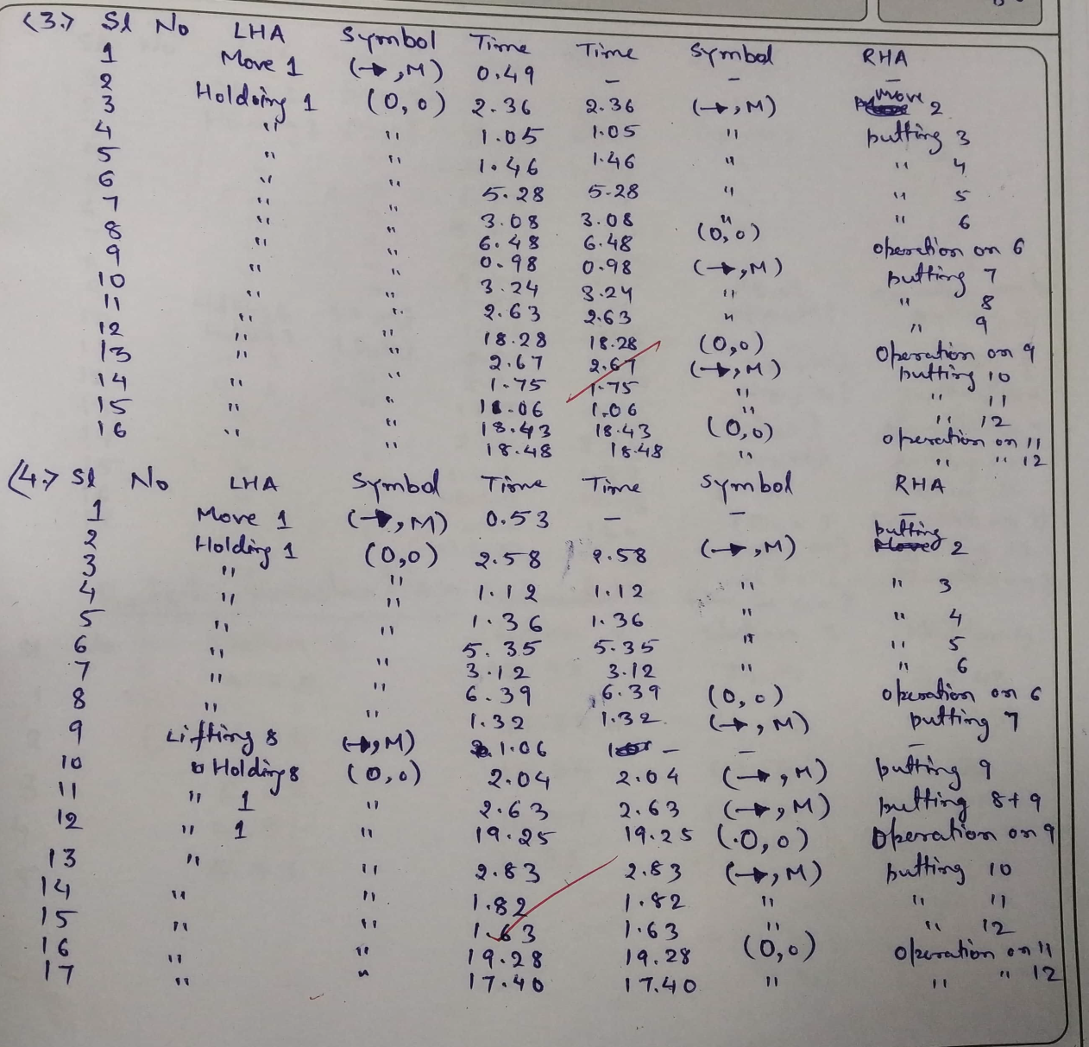
Data:

Slide 9
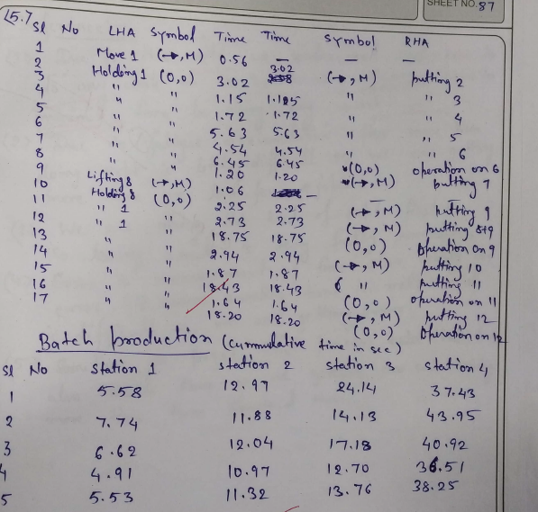

Slide 10
Result
Job Trials | Time taken to complete the job (sec)
1 | 75.34
2 | 75.67
3 | 76.81
4 | 89.71
5 | 92.14
Job Trials | Time taken to complete the job (sec)
1 | 37.43
2 | 43.95
3 | 40.92
4 | 36.51
5 | 38.25
Individual Assembly
Trial 1 takes less time. Therefore, trial 1 is best among 5 trials.
Batch Assembly
Trial 4 takes less time. Therefore, trial 4 is best among 5 trials.

